Slide 1
Blinking an LED
…. The hard way.

Slide 2
In Linux, everything is a file
Learning about Linux through SYSFS
Thanks to Bill Gatliff

Slide 3
The file interface abstraction
What can we do with files?
open, read, write, close, delete
What is an ‘ioctl’?
Gets you to the hardware!
What is a virtual file system?
Looks like a file, but executes code in the driver
Not really storing anything to media
A bit like a “ram disk”

Slide 4
What is SYSFS?
Virtual file system that exposes drivers to userspace
/sys/devices ← driver hierarchy
/sys/class ← common interfaces
Let’s go thru some examples…

Slide 5
What is SYSFS?
Virtual file system that exposes drivers to userspace
/sys/devices ← driver hierarchy
/sys/bus ← links to bus owners
/sys/class ← common interfaces
/sys/block ← block interface
Let’s go thru some examples…

Slide 6
What is SYSFS?
Virtual file system that exposes drivers to userspace
bone$ cd /sys/class
bone$ ls
backlight firmware lcd net scsi_device tty
bdi gpio leds power_supply scsi_disk udc
block graphics mbox pwm scsi_generic usb_device
bluetooth hwmon mdio_bus regulator scsi_host vc
bsg i2c-adapter mem rfkill sound video4linux
devfreq i2c-dev misc rtc spi_master vtconsole
display input mmc_host scsi_changer spidev
Let’s go through some examples…

Slide 7
Blinking an LED
Everything is a file in Linux
$ cd /sys/class/leds
$ ls -F
bat100 beaglebone:green:usr0 green
bat25 beaglebone:green:usr1 red
bat50 beaglebone:green:usr2 wifi
bat75 beaglebone:green:usr3 wl18xx_bt_en $ cd beaglebone\:green\:usr0
$ ls
brightness max_brightness subsystem uevent
device power trigger

Slide 8
Blinking an LED
$ cat trigger
none nand-disk mmc0 timer oneshot [heartbeat]
backlight gpio cpu0 default-on transient
$ echo none > trigger
$ echo 1 > brightness
$ echo 0 > brightness

Slide 9
Blinking an External LED
The gpio pins are accessed through
/sys/class/gpio
Earlier we used gpio GP0_3
The table shows which gpio pin it’s assigned to

Slide 10
JST | gpio | gpio | Black Header
GP0_3 | gpio1_25 | 57
GP0_4 | gpio1_17 | 49 | P9_23
GP0_5 | gpio3_20 | 116 | P9_41B
GP0_6 | gpio3_17 | 113 | P9_28
GP1_3 | gpio3_20 | 98
GP1_4 | gpio3_17 | 97
PAUSE | gpio2_5 | 69 | P8_9
MODE | gpio2_4 | 68 | P8_10

Slide 11
Blinking an External LED
The gpio pins are accessed through
/sys/class/gpio
Earlier we used gpio P9_14
The table shows which gpio pin it’s assigned to

Slide 12
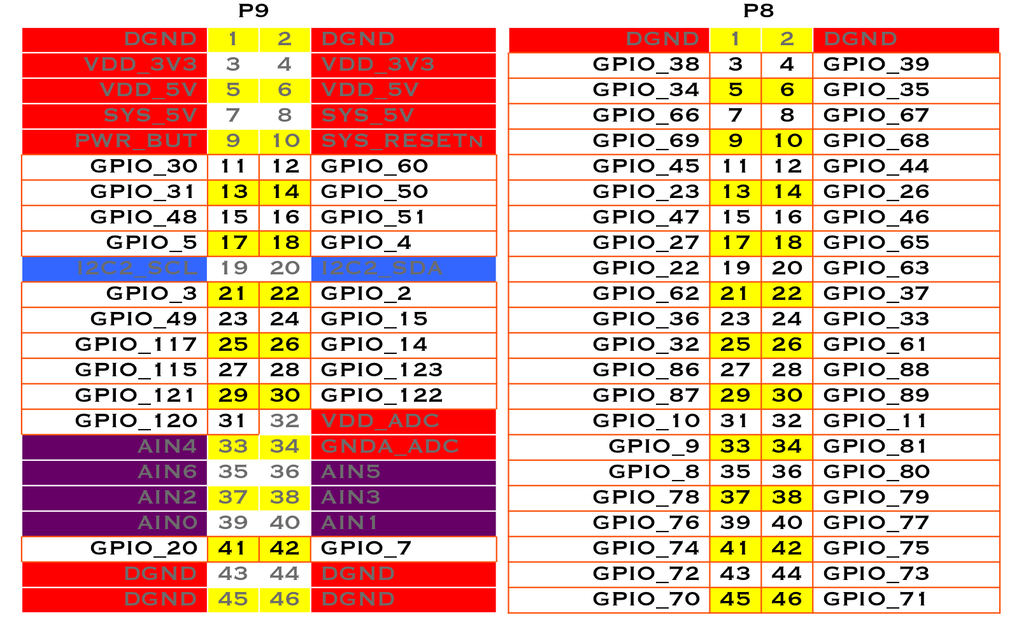

Slide 13
Blinking an External LED
Here’s how you turn it on
$ cd /sys/class/gpio
$ ls
export gpiochip0 gpiochip32 gpiochip64 gpiochip96 unexport
No gpio pins are visible. Use GP0_4
$ echo 49 > export
$ ls
export gpio57 gpiochip0 gpiochip32 gpiochip64 …
Notice gpio49 has appeared

Slide 14
Blinking an External LED
Go in a take control
bone$ cd gpio49
bone$ ls
active_low direction edge power subsystem uevent value
bone$ echo out > direction
bone$ echo 1 > value
Your LED should be on

Slide 15
Reading a switch
Once you know how to control an LED, reading a switch is easy
A switch is wired to GP0_3. Which gpio is this?
$ cd /sys/class/gpio
$ echo 57 > export
$ cd gpio57
$ echo in > direction

Slide 16
Reading a Switch
Button not pushed
$ cat value
0
Button pushed
$ cat value
1

Slide 17
Read in a Loop
Space are important
Spaces are important
You can read the switch over and over
#!/bin/bash
cd /sys/class/gpio
while [ 1 ]
do
cat gpio57/value
sleep 0.25
done
tr '\n' '\r' < gpio57/value

Slide 18
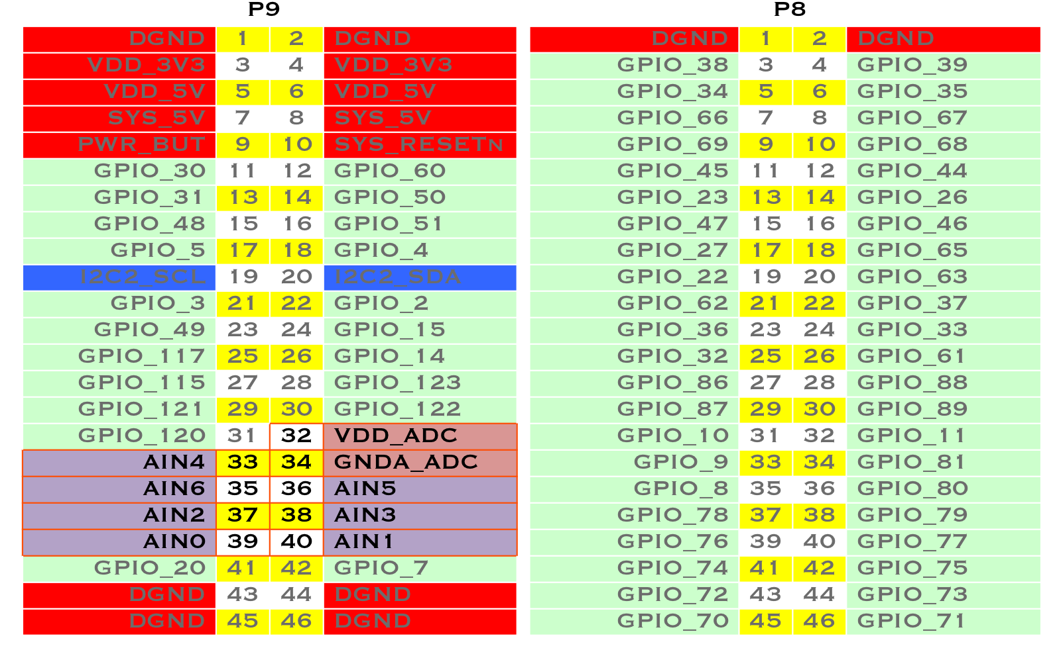
Analog In
The Bone has several Analog Inputs

Slide 19
Analog In
Input voltage range is 0 to 1.8V.
These are accessed much link the gpio
$ export SLOTS="/sys/devices/platform/bone_capemgr/slots"
$ echo BB-ADC > $SLOTS
$ cd /sys/bus/iio/devices/iio:device0
$ ls -F
buffer/ in_voltage1_raw in_voltage4_raw name scan_elements/
dev in_voltage2_raw in_voltage5_raw of_node@ subsystem@
in_voltage0_raw in_voltage3_raw in_voltage6_raw power/ uevent
$ cat in_voltage0_raw
3936

Slide 20
Analog In - Explore
How did I figure this out?
The variable NODE_PATH tells where the node modules are kept
bone$ echo $NODE_PATH
/usr/local/lib/node_modules
See what’s there
bone$ ls $NODE_PATH
async i2c node-red-node-bb-upm npm serialport
blessed mraa node-red-node-beaglebone request socket.io
bonescript node-red node-red-node-mongodb sensortag winston

Slide 21
Analog In - Explore
bone$ cd $NODE_PATH/bonescript
bone$ ls
autorun.js bonescript.version LICENSE node_modules server.js test
bonescript.node_version dts main.js package.json src
bonescript.npm_version etc Makefile README.md systemd
bone$ cd src
bone$ ls
autorun.js eeprom.js hw_oldkernel.js index.js serial.js
bone.js functions.js hw_simulator.js my.js server.js
bonescript.js hw_capemgr.js hw_universal.js parse.js socket_handlers.js
constants.js hw_mainline.js iic.js rewrite_bone.js
What now?

Slide 22
Analog In - Explore
bone$ grep analog *
…
index.js: f.analogRead = function(pin, callback) {
…
Look in index.js
resp = hw.readAIN(pin, resp, callback);
bone$ grep readAIN *
hw_mainline.js: exports.readAIN = function(pin, resp, callback) {

Slide 23
Analog In - Explore
In hw_mainline.js you find:
var ainPrefix = "/sys/bus/iio/devices/iio:device0";
var SLOTS = "/sys/devices/platform/bone_capemgr/slots";
var AINdts = "BB-ADC";
$ export SLOTS="/sys/devices/platform/bone_capemgr/slots"
$ echo BB-ADC > $SLOTS
$ cd /sys/bus/iio/devices/iio:device0

Slide 24
Analog In
Input voltage range is 0 to 1.8V.
These are accessed much like the gpio
$ cd /sys/devices/ocp.3/helper.16
$ ls
AIN0 AIN2 AIN4 AIN6 driver power uevent
AIN1 AIN3 AIN5 AIN7 modalias subsystem
$ cat AIN6
1185

Slide 25
Analog In
Input voltage range is 0 to 1.8V.
These are accessed much like the gpio
$ SLOTS=/sys/devices/bone_capemgr.*/slots
$ echo cape-bone-iio > $SLOTS
$ cd /sys/devices/ocp.3/helper.16
$ ls
AIN0 AIN2 AIN4 AIN6 driver power uevent
AIN1 AIN3 AIN5 AIN7 modalias subsystem
$ cat AIN6
1185

Slide 26
Analog In
You can keep reading the input using
while [ 1 ]
do
tr '\n' '\r' < in_voltage0_raw
done

